Slide 1
ClaimBuster:
The Quest to Automate Fact-Checking
Chengkai Li
Associate Professor, Department of Computer Science and Engineering
Director, Innovative Database and Information Systems Research (IDIR) Laboratory
University of Texas at Arlington
Duke University, Feb. 8th, 2016

Slide 2
Confession/Disclaimer
The talk is fairly non-technical.
I am not politically savvy.

Slide 3

“Stupidest Statistics” and “Goofy Combinations”
http://n.pr/1nQtb8F

Slide 4

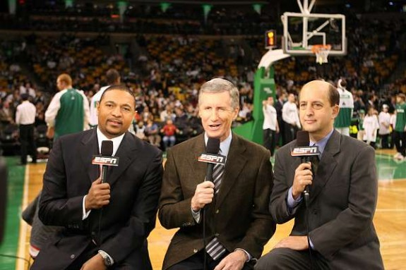

How I Got into Computational Journalism
Chris Paul had 16 points, 10 rebounds, 13 assists and five steals…… The only other active player to have such a game is Jason Kidd…
2009
How did they come up with that?

Slide 5
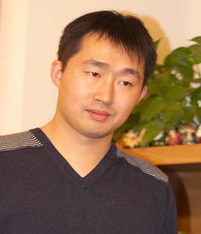
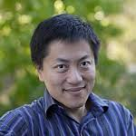
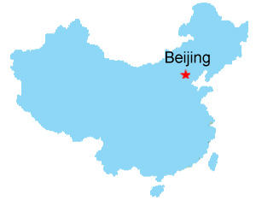

How I Got into Computational Journalism
I’m designing algorithms to find such facts.
2010
It is a computational journalism problem.
#@%&!#!%

Slide 6
How I Got into Computational Journalism
2010-present
Collaboration between Duke, Google Research, Stanford, and UTA. Collaboration with Chinese Academy of Sciences and HP Labs China.
Story-finding: finding and monitoring number-based facts pertinent to real-world events. The facts are leads to news stories.
Fact-checking: discovering and checking factual claims in political discourses, social media, and news.

Slide 7
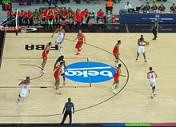
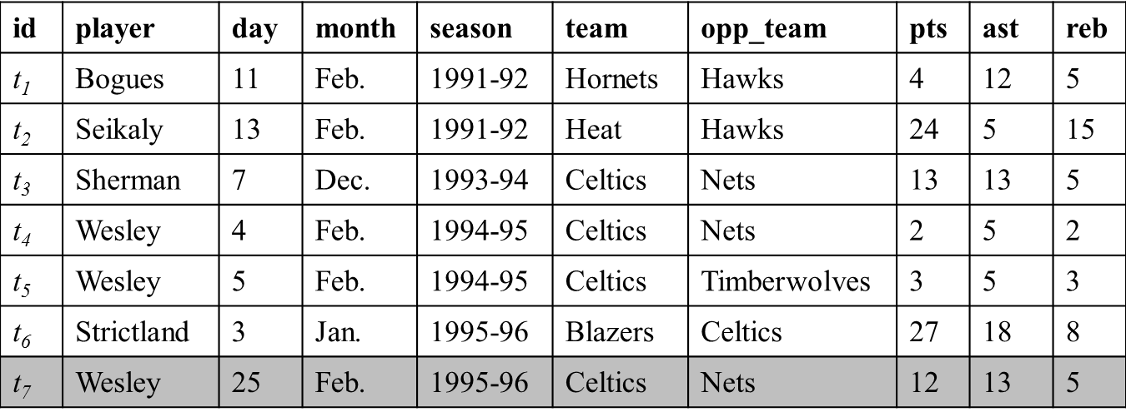
Story-finding
Finding and monitoring number-based facts pertinent to real-world events. The facts are leads to news stories.
New tuple appended to database
Real-world event (sports, transportation, crime, weather, finance, social media)
Wesley had 12 points, 13 assists and 5 rebounds on February 25, 1996 to become the first player with a 12/13/5 (points/assists/rebounds) in February.
Find facts
Generate factual claim
http://en.wikipedia.org/wiki/Basketball

Slide 8
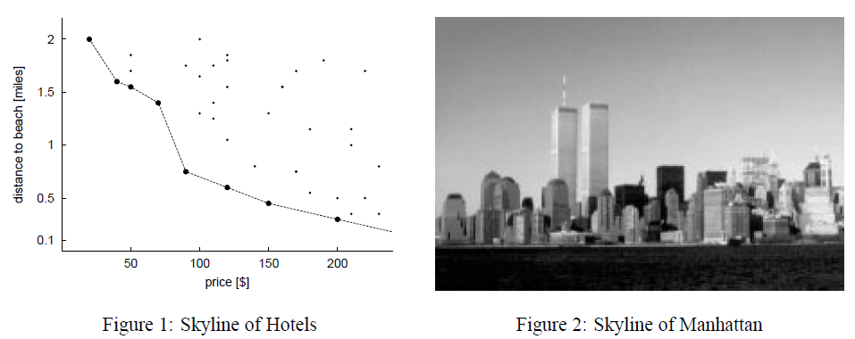
Story-finding
Many interesting facts in the real-world can be modeled as skyline points.
Stephan Börzsönyi, Donald Kossmann, Konrad Stocker: The Skyline Operator. ICDE 2001: 421-430

Slide 9
Story-finding: Prominent Streaks
Long consecutive subsequence of high values in a sequence
“This month the Chinese capital has experienced 10 days with a maximum temperature in around 35 degrees Celsius – the most for the month of July in a decade.” http://www.chinadaily.com.cn/china/2010-07/27/content_11055675.htm
“The Nikkei 225 closed below 10000 for the 12th consecutive week, the longest such streak since June 2009.”
http://www.bloomberg.com/news/articles/2010-08-06/japanese-stocks-fall-for-second-day-this-week-on-u-s-jobless-claims-yen
Prominent Streak Discovery in Sequence Data. Xiao Jiang, Chengkai Li, Ping Luo, Min Wang, Yong Yu. KDD 2011, pages 1280-1288.
Discovering General Prominent Streaks in Sequence Data. Gensheng Zhang, Xiao Jiang, Ping Luo, Min Wang, Chengkai Li. ACM TKDD, 8(2):article 9, June 2014.

Slide 10
Story-finding: One-of-the-few Objects
Qualifying statements that can only be made for very few objects
Chris Paul had 16 points, 10 rebounds, 13 assists and five steals …… The only other active player to have such a game is Jason Kidd… http://espn.go.com/espn/elias?date=20080407
On "One of the Few" Objects. You Wu, Pankaj K. Agarwal, Chengkai Li, Jun Yang, Cong Yu. KDD 2012, pages 1487-1495.

Slide 11
Story-finding: Situational Facts
Comparison contexts and spaces that make a given object stand out
“The social world’s most viral photo ever generated 3.5 million likes, 170,000 comments and 460,000 shares by Wednesday afternoon.” http://www.cnbc.com/id/49728455
Incremental Discovery of Prominent Situational Facts. Afroza Sultana, Naeemul Hassan, Chengkai Li, Jun Yang, Cong Yu. ICDE 2014, pages 112-123.

Slide 12
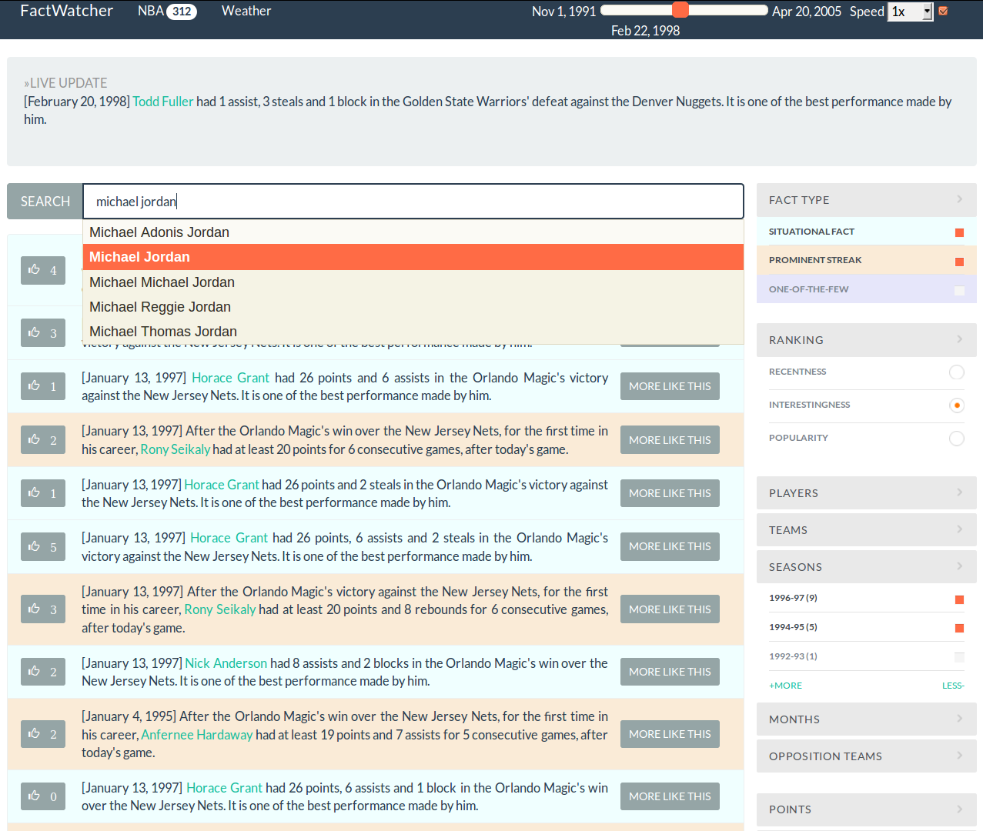


FactWatcher
idir.uta.edu/factwatcher
https://vimeo.com/154356599
Excellent Demo Award
Data In, Fact Out: Automated Monitoring of Facts by FactWatcher. Naeemul Hassan, Afroza Sultana, You Wu, Gensheng Zhang, Chengkai Li, Jun Yang, and Cong Yu. VLDB 2014, pages 1557-1560. Demonstration description.

Slide 13
Fact-checking

Slide 14
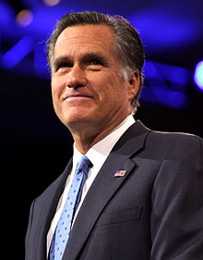

People Make Claims All the Time
“… our Navy is smaller than it's been since 1917", said Republican candidate Mitt Romney in third presidential debate in 2012.
http://en.wikipedia.org/wiki/Mitt_Romney
http://www.thebrainchildgroup.com/

Slide 15
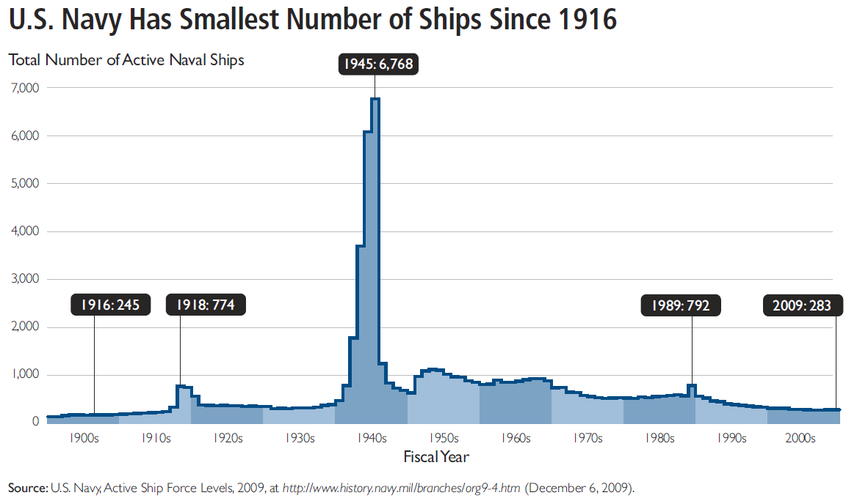
Fact-checking is not Easy
“… our Navy is smaller than it's been since 1917", said Republican candidate Mitt Romney in third presidential debate in 2012.
http://en.wikipedia.org/wiki/Mitt_Romney
http://s3.amazonaws.com/thf_media/2010/pdf/Military_chartbook.pdf

Slide 16
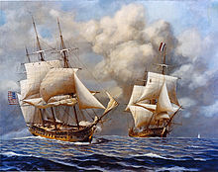
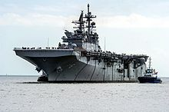
Fact-checking is not Easy
“… our Navy is smaller than it's been since 1917", said Republican candidate Mitt Romney in third presidential debate in 2012.
vs
http://en.wikipedia.org/wiki/Mitt_Romney
http://s3.amazonaws.com/thf_media/2010/pdf/Military_chartbook.pdf
http://en.wikipedia.org/wiki/United_States_Navy

Slide 17
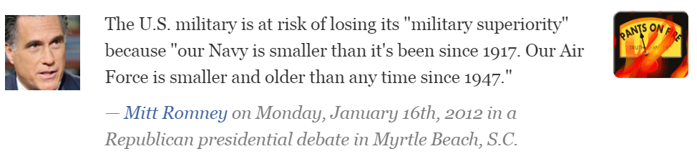
Existing Fact-checking Platforms
Journalists and reporters spend good amount of time on fact checking
64 active fact-checking sites in 2015 (PolitiFact .com, FactCheckEU.org, FullFact.or , Factcheck .org
CNN, Washington Post , New York Times, Poynter, American Press Institute, …)
http://reporterslab.org/snapshot-of-fact-checking-around-the-world-july-2015/

Slide 18
Fact-Checking is Time-Consuming and Resource-Demanding
Journalists spend hours going through documents to identify claims.
Research on factual claims can take days (finding data sources, finding experts).
Long gap from when a claim is made to when it is checked

Slide 19
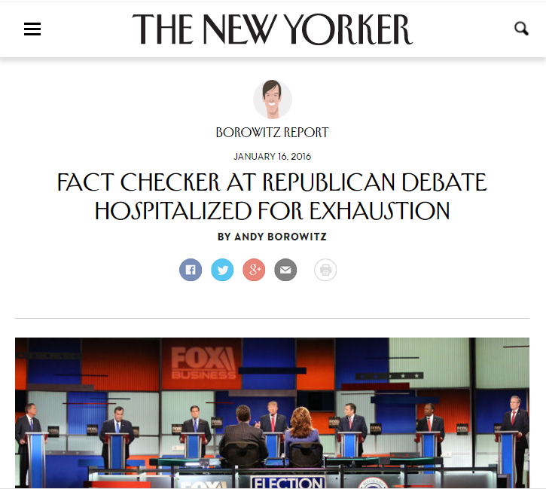
“Total Physical and Mental Collapse”

Slide 20
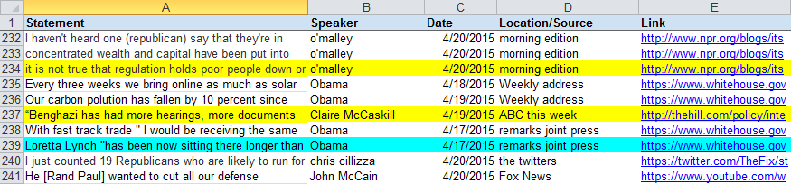
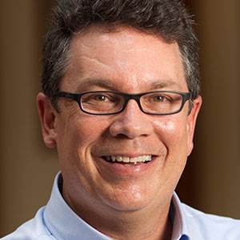
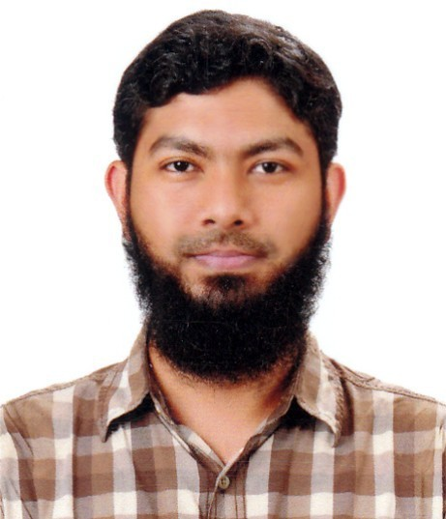
PolitiFact “Buffet” of Factual Claims
2014
This is what they eat at PolitiFact.
Let me work on its automation.

Slide 21

The Quest to Automate Fact-Checking

Slide 22
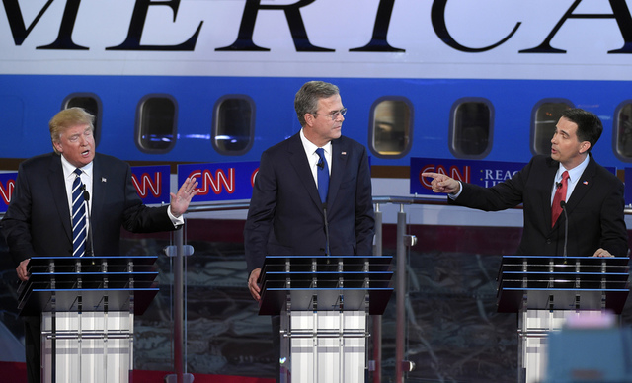

ClaimBuster for 2016
Factual claims recommended for checking
2016
Presidential
Debates
Journalists investigate the claims

Slide 23
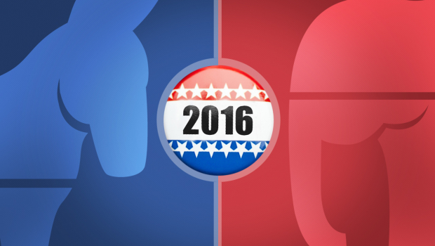


Finding Important Factual Claims:
A Supervised Learning Task
2016
Presidential
Debates
Human Annotation
Feature Extraction
Learning Algorithm
Ground Truth
Feature Vectors
Presidential Debate Transcripts (1960-2012)
Important factual claims

Slide 24
Dataset: Presidential Debate Transcripts
Source: http://www.debates.org/index.php?page=debate-transcripts
All 30 debates (11 general elections) in history: 1960, 1976—2012
20k sentences by presidential candidates: removed very short (< 5 words) sentences

Slide 25
3 Classes of Sentences
CFS: Important factual claims
“We spend less on the military today than at any time in our history.” “The President’s position on gay marriage has changed.” “More people are unemployed today than four years ago.”
UFS: Unimportant factual claims
“I was in Iowa yesterday.” “My mother enjoys cooking.” “I ran for President once before.”
NFS: No factual claims (just opinions, questions & declarations)
“Iran must not get nuclear weapons.” “7% unemployment is too high.” “My opponent is wishy-washy.” “I will be tough on crime.” "Why should we do that?“ “Hello, New Hampshire!” “Our plan is to reduce tax rate by 10%.”

Slide 26
3 Classes of Sentences
If a sentence contains an opinion and an important factual claim, it shouldn’t be labelled “No factual claims”.
“Unemployment rate is too high and in last four years it increased from 8% to 10%.”

Slide 27
Ranking and Classification Problems
Classification
Given a future sentence, find the class it belongs to.
Ranking
Rank sentences based on how likely they contain important factual claims.

Slide 28
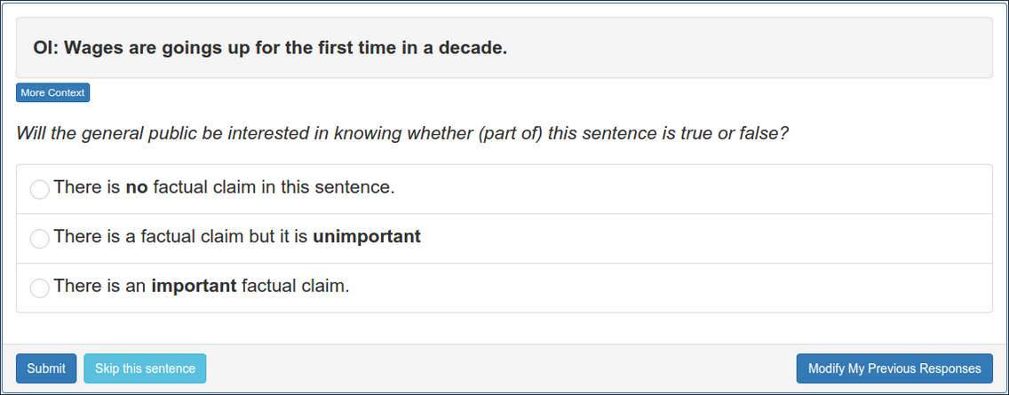
Ground Truth Collection Website

Slide 29
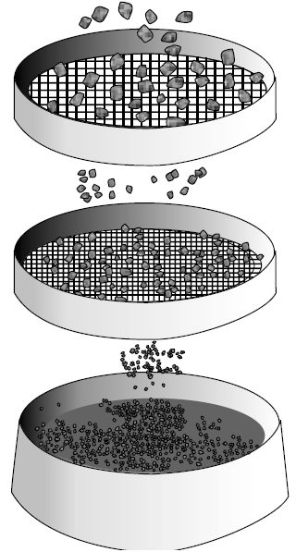
Ground Truth Collection
10 months (in 3 stages)
~$3,000 paid
1032 screening sentences (by 3 experts) to detect spammers & low-quality coders
329 coders
51925 labels
53 top-quality coders
26853 labels
Class | Count
CFS | 1561
UFS | 418
NFS | 5347
53 top-quality coders
14652 labels in agreement
7326 admitted sentences
http://www.engineersdaily.com/2014/03/basics-of-soil-compaction.html

Slide 30
Feature Extraction
Word:
state, legislature, 87, percent, democrat
Sentiment: 0.032
I was in a state where my legislature was 87 percent Democrat.
Part-of-Speech:
Noun
Entity Type:
Quantity
Concept:
United States
Sentiment: [-1.0 to 1.0]
Word: tf-idf scores of 6130 words (excluding rare words)
POS Tag: 43 tags
Entity Type: 26 types

Slide 31
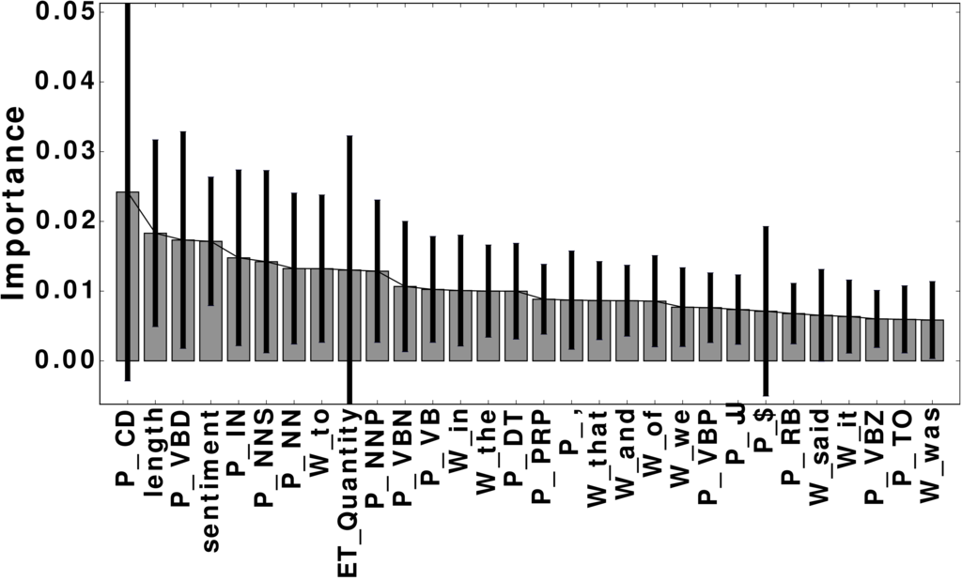
Feature Importance
6201 features in total
Used a Random Forest Classifier to calculate the importance of each feature.
Word | percent; people; jobs
POS Tag | noun; cardinal number; past tense; preposition
Entity Type | Quantity; Country; FieldTerminology; Person
Concept | United States Senate; Barack Obama
Sentiment

Slide 32
Evaluation: Classification
4-fold cross validation
Methods: Naive Bayes (NBC), Random Forest (RFC), Support Vector Machine (SVM)
In general, SVM, using Word + POS, performed better than other combinations.
 | Precision | Recall | F-measure
NFS | 0.90 | 0.96 | 0.93
UFS | 0.65 | 0.26 | 0.37
CFS | 0.79 | 0.74 | 0.77

Slide 33
Evaluation: Ranking
NBC, RFC, SVM all allow ranking.
Accuracy of top-K sentences ranked by ClaimBuster, using the admitted sentences from top-coders as ground truth.
ClaimBuster has a strong agreement with top-quality human coders on the check-worthiness of sentences.
K | P@K | NDCG@K
25 | 1 | 1
50 | 1 | 1
100 | 0.960 | 0.970
200 | 0.940 | 0.951
300 | 0.853 | 0.881
500 | 0.690 | 0.840

Slide 34
Case Study: Republican/Democratic Primary Debates in 2015
CNN Claim | Associated sentence(s) [From TextGrabber] | Score
1 | Part of this iranian deal was lifting the international sanctions on general sulemani. | 0.415
2 | I would go on to add – >> you don’t favor – >> i have never said that. | 0.511
3 | A majority of the candidates on this stage supported amnesty. | 0.295
4 | Timely the medicaid is growing at one of the lowest rates in the country. | 0.534
4 | We went from $8 billion in the hole to $5 million in the black. | 0.773
5 | And the mexican government is much smarter, much sharper, much more cunning and they send the bad ones over because they don’t want to pay for them. | 0.215
6 | [Not found in the transcript] | N/A

Slide 35
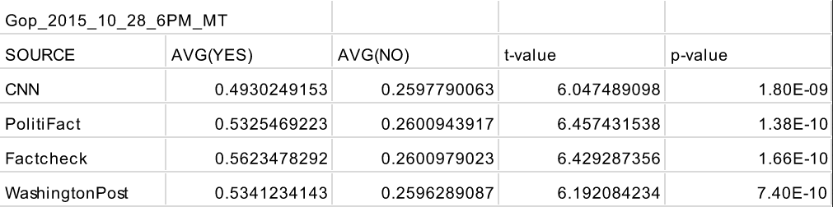
Case Study: Republican/Democratic Primary Debates 2015-2016
For all debates, significant differences between ClaimBuster scores on Group 1 (sentences checked by professionals) and Group 2 (the rest)

Slide 36
Case Study: Republican/Democratic Primary Debates in 2015
K | P@K | NDCG@K
10 | 0.4 | 0.441
20 | 0.45 | 0.456
30 | 0.367 | 0.401
40 | 0.325 | 0.368
50 | 0.3 | 0.346
Ranked all 1393 sentences from the Aug. 6th debate
Used the 59 claims in PolitiFact “buffet” as the ground truth

Slide 37
More Details
Detecting Check-worthy Factual Claims in Presidential Debates. Naeemul Hassan, Chengkai Li, Mark Tremayne. CIKM 2015, pages 1835-1838.
The Quest to Automate Fact-Checking. Naeemul Hassan, Bill Adair, James Hamilton, Chengkai Li, Mark Tremayne, Jun Yang and Cong Yu. 2015 Computation+Journalism Symposium.

Slide 38
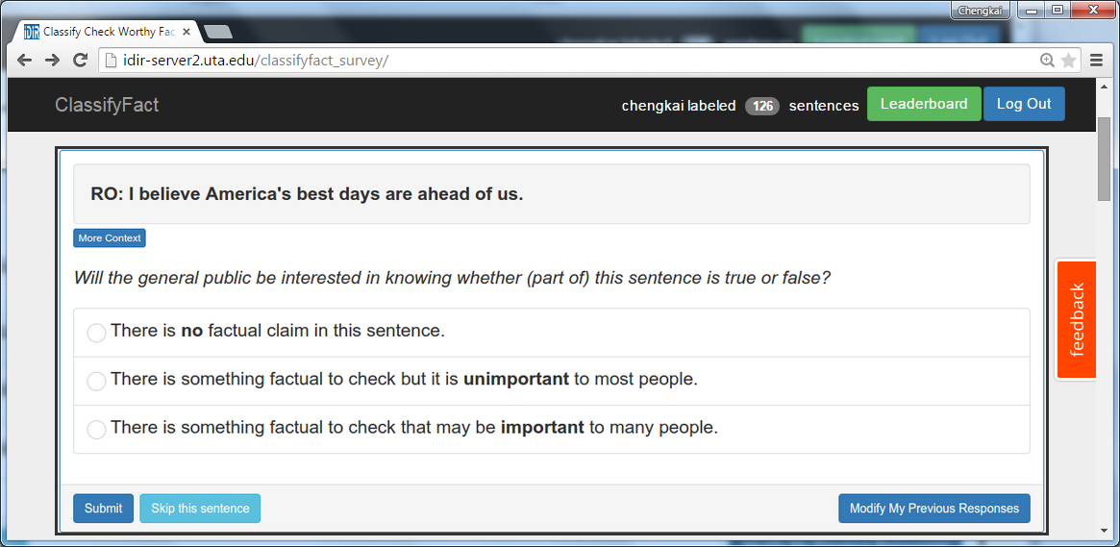

You are Invited to Contribute
http://bit.ly/claimbusters

Slide 39
Live Coverage of Debates
Extracted closed captions of debates on broadcast TV channels using TextGrabber
Finding speaker identity using Twitter
Tweeted important factual claims to https://twitter.com/ClaimBusterTM, live!

Slide 40
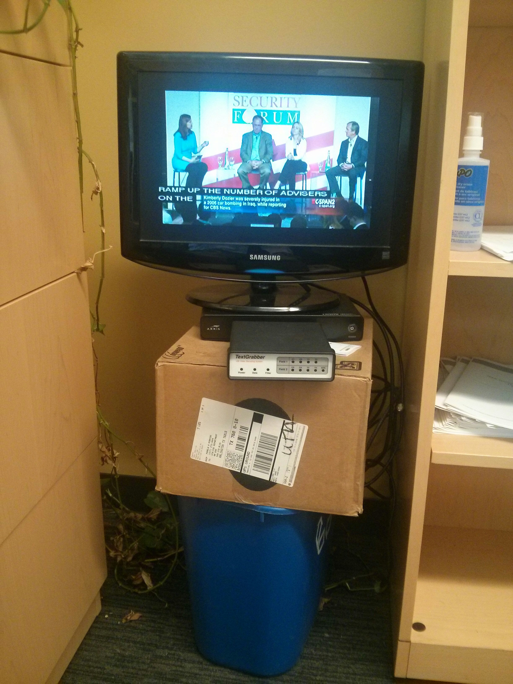
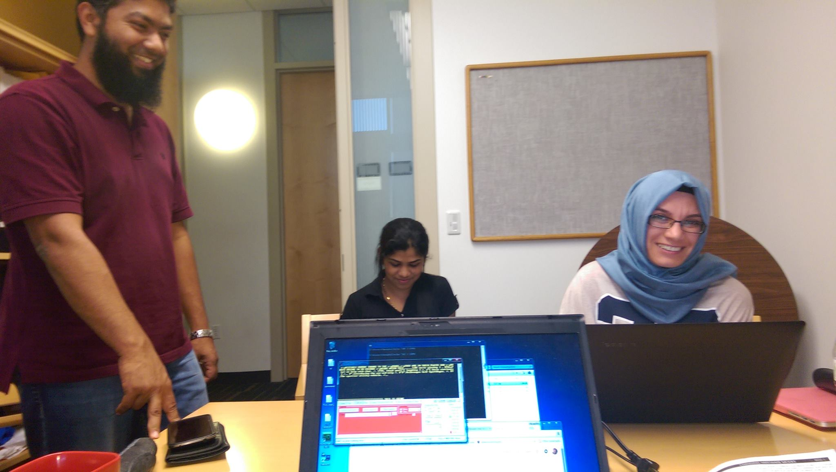

Slide 41
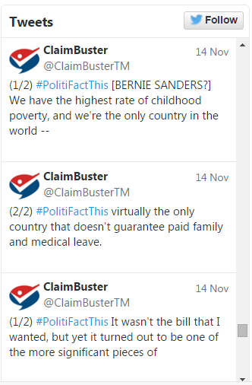
Claims Tweeted

Slide 42
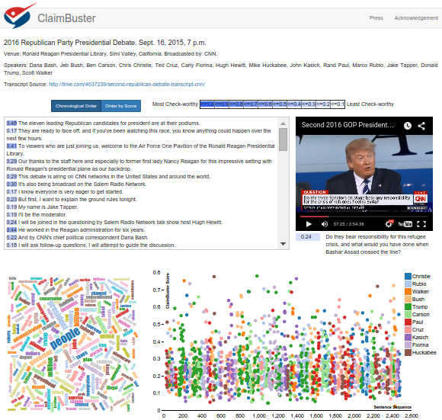

Demo
http://idir.uta.edu/claimbuster

Slide 43
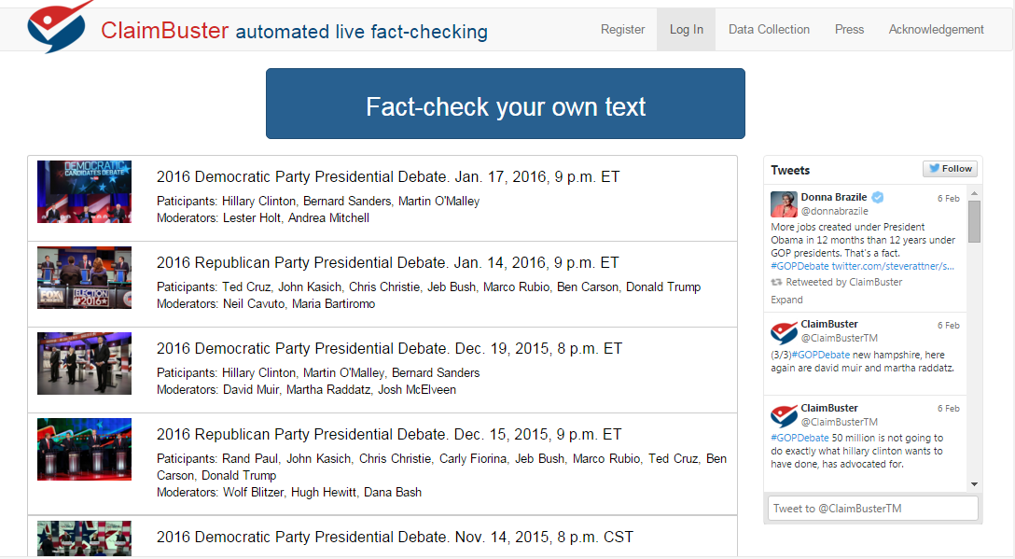

Slide 44
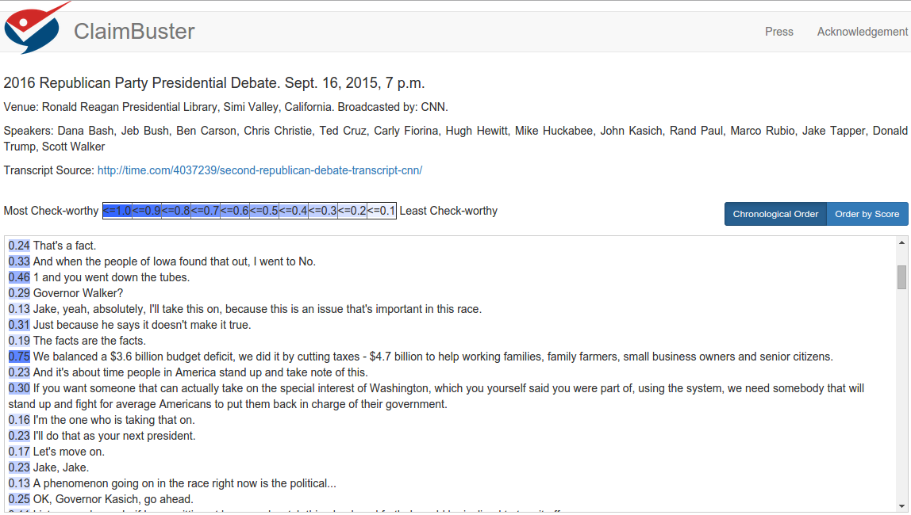

Slide 45
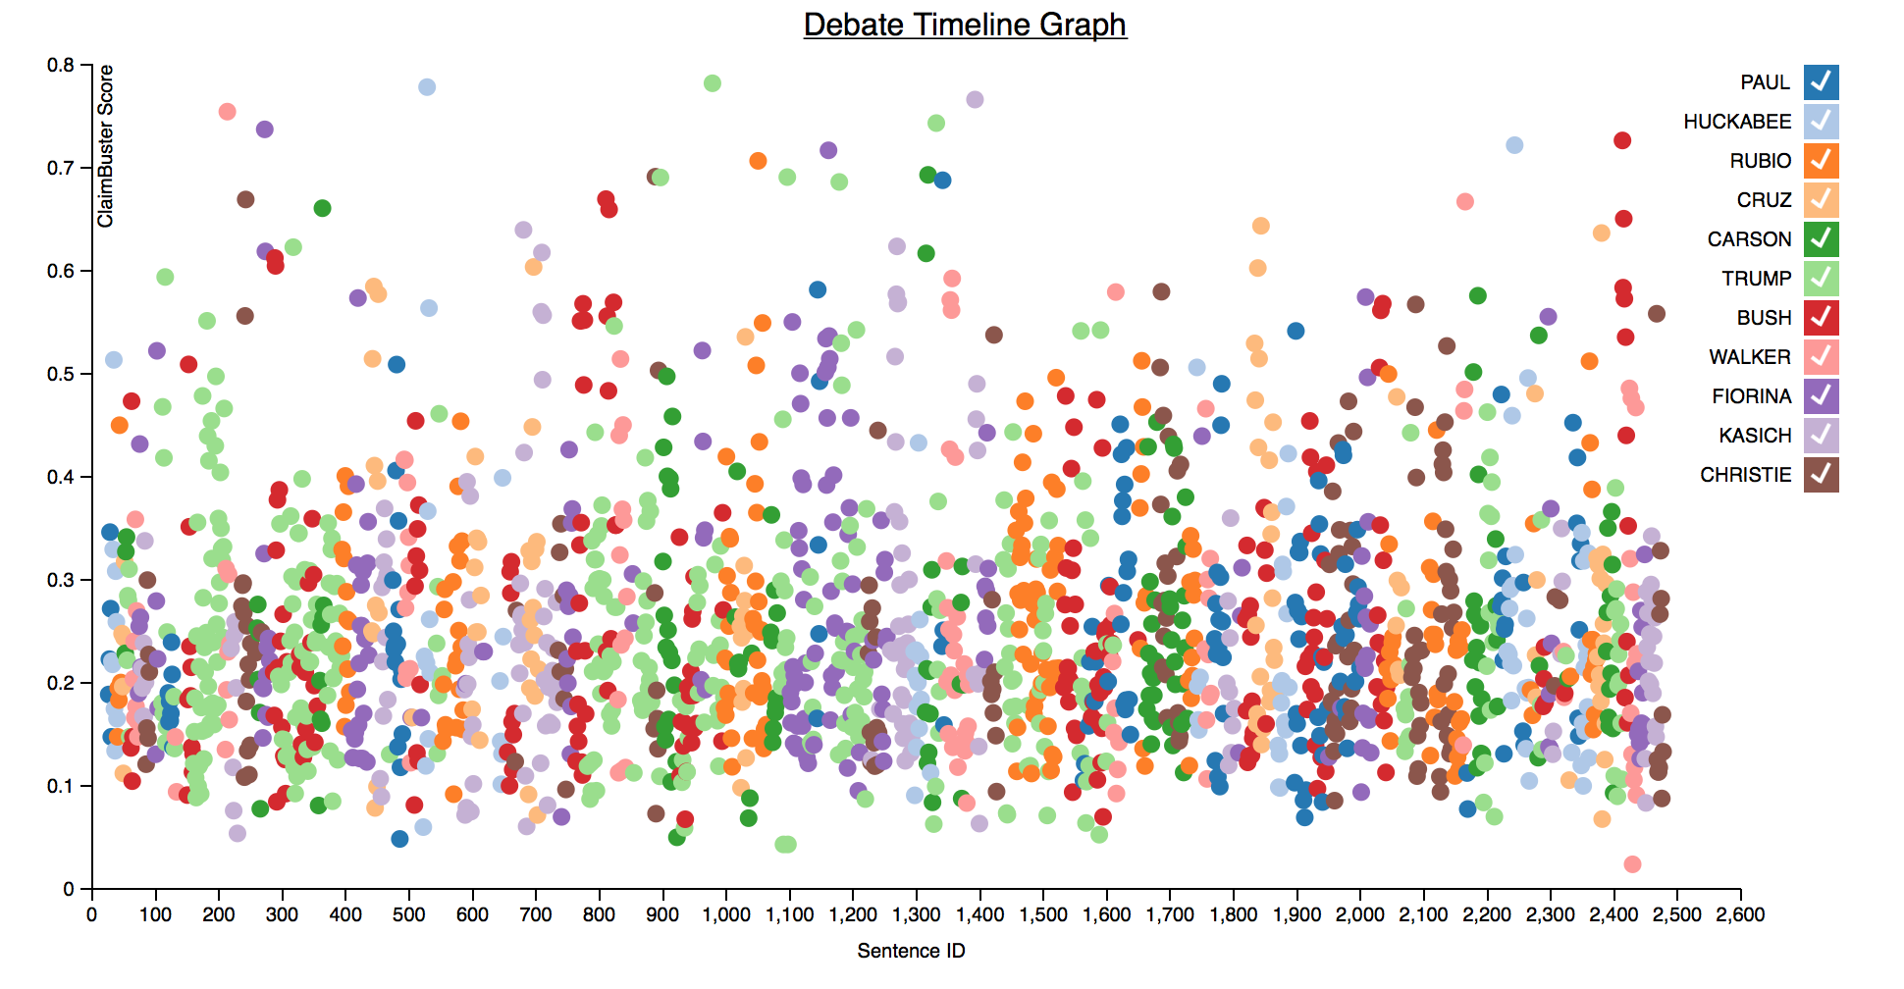

Slide 46
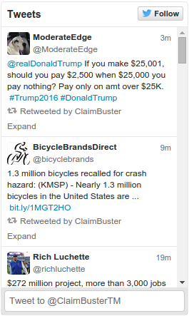
Retweeting Claims in Tweets

Slide 47
Retweeting Claims in Tweets
Tweets from Twitter API
(50,287,283)
August 1st to October 31st, 2015
Query:
Keywords: 400 unigram/bigram/trigram from 30 debates
Twitter accounts: 220 accounts from 10 lists of politicians, government offices, organizations, …
Unique tweets
(26,726,483)
Scores > 0.75
(49,509)
After removing duplicates and junk
(18,266)
Political tweets
(~9,000)

Slide 48

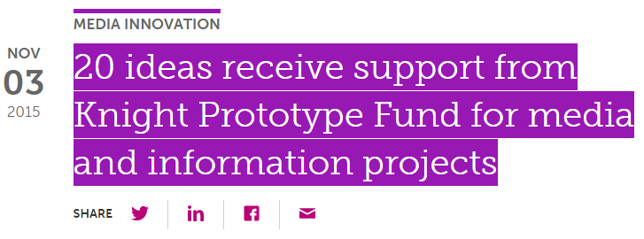
Media Coverage

Slide 49

Commercialization

Slide 50
The Quest to Automate Fact-Checking

Slide 51
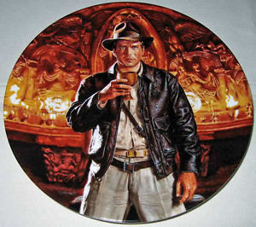
The Holy Grail: Automated, Live Fact-Checking

Slide 52
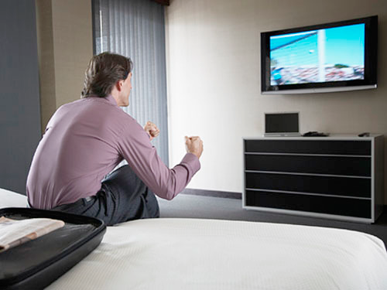
The Holy Grail
Source: Bill Adair

Slide 53

The Holy Grail
Source: Bill Adair

Slide 54
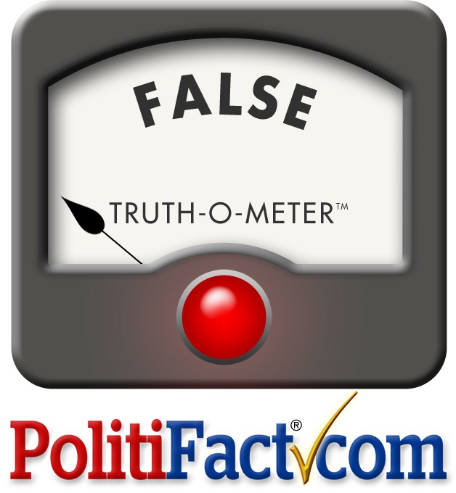
The Holy Grail
Source: Bill Adair

Slide 55
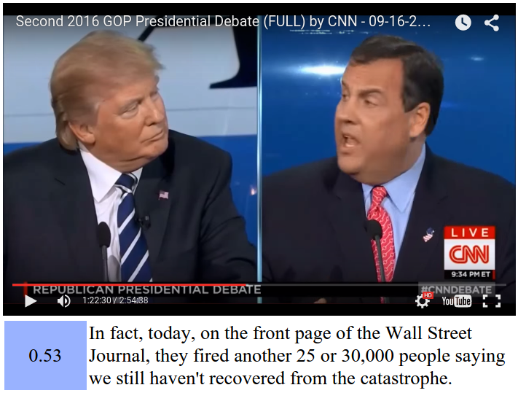
A Partial Mock Interface

Slide 56
ClaimBuster
live events (debates, interviews, congressional debates) and ads on TV and online video streams
social media (e.g., twitter)
web pages
news articles
repository of already-checked claims
important factual claims
detector
matcher
no match
matched
solicit analyses from professionals;
crowd;
data analysis, algorithmic fact-checking
display existing fact-checkers, delivered via browser extensions, mobile and smart-TV apps
www.wsandb.co.uk/wsb/news/2405401/european-court-rules-insurers-need-to-include-economic-consequences-of-policies#
www.outsidethebeltway.com

Slide 57
ClaimBuster
live events (debates, interviews, congressional debates) and ads on TV and online video streams
social media (e.g., twitter)
web pages
news articles
repository of already-checked claims
important factual claims
detector
matcher
no match
matched
solicit analyses from professionals;
crowd;
data analysis, algorithmic fact-checking
display existing fact-checkers, delivered via browser extensions, mobile and smart-TV apps
www.wsandb.co.uk/wsb/news/2405401/european-court-rules-insurers-need-to-include-economic-consequences-of-policies#
www.outsidethebeltway.com

Slide 58
Algorithmic Fact-checking
Toward Computational Fact-Checking. You Wu, Pankaj K. Agarwal, Chengkai Li, Jun Yang, Cong Yu. VLDB 2014, pages 589-600.
iCheck: computationally combating "lies, d-ned lies, and statistics". You Wu, Brett Walenz, Peggy Li, Andrew Shim, Emre Sonmez, Pankaj K. Agarwal, Chengkai Li, Jun Yang, Cong Yu. SIGMOD 2014, pages 1063-1066.
A lot is being done at Duke.

Slide 59
Acknowledgment
UTA Students
Naeemul Hassan
Fatma Arslan
Joseph Minumol
Gensheng Zhang
Vikas Sable
Siddhantsanjeev Gawsane
Pratik Palashikar
Collaborators
Bill Adair (Duke)
Pankaj Agarwal (Duke)
James Hamilton (Stanford)
Ping Luo (Chinese Academy of Science)
Mark Tremayne (UTA)
Min Wang (Visa)
You Wu (Google)
Jun Yang (Duke)
Cong Yu (Google Research)

Slide 60




Acknowledgment
Funding sponsors
Disclaimer: This material is based upon work partially supported by the National Science Foundation Grants 1018865, 1117369, 1408928 and 1565699, a Knight Prototype Fund from the Knight Foundation, 2011 and 2012 HP Labs Innovation Research Awards, and the National Natural Science Foundation of China Grant 61370019. Any opinions, findings, and conclusions or recommendations expressed in this material are those of the author(s) and do not necessarily reflect the views of the funding agencies.

Slide 61
Thank You! Questions?
http://ranger.uta.edu/~cli
cli@uta.edu
Demo
http://idir.uta.edu/claimbuster
Please help us label the data
http://bit.ly/claimbusters

